Slide 1
Amazon Redshift
Cloud Data Warehouse
Guilherme Nogueira

Slide 2
What is Redshift?
1 | Cloud-based data warehouse (AWS)
2 | Columnar storage for performance
3 | Massively Parallel Processing (MPP)
4 | SQL-based, built for analytics

Slide 3
How Redshift Works
Massively Parallel Processing (MPP) | Columnar Data Storage
Leader node parses queries and creates exec plans | Stores data by columns, not rows
Distributes tasks to compute nodes | Reads only relevant columns (faster I/O)
Compute nodes run in parallel (slices) | Advanced compression saves space
Results aggregated and sent back | COPY command for fast S3 ingestion

Slide 4
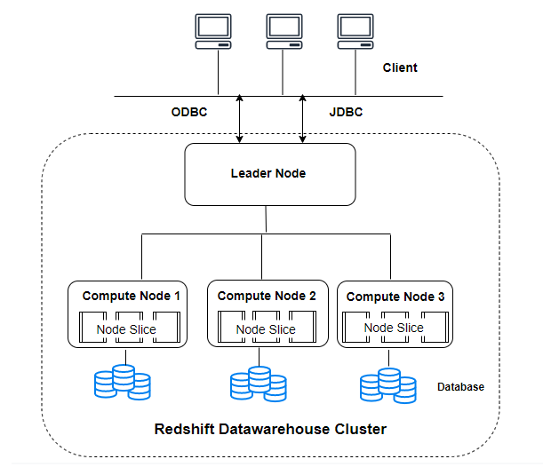
Internal Architecture
Leader Node
Compute Nodes
RA3 Nodes
Coordinates queries, creates execution plans, communicates with clients
Execute compiled code in parallel, process data in slices
Decouple compute and storage for independent scaling
Redshift Managed Storage (RMS)
Node Slices
Partitions of compute nodes that process in parallel
Uses high-performance SSD cache + S3

Slide 5
Trade-offs
PROS | CONS
High performance with MPP | Needs tuning (sort/dist keys)
Decoupled compute/storage (RA3) | Not fully serverless
SQL-native, AWS-integrated | Limited JSON/nested data support

Slide 6



Comparison with Other Tools
Redshift (AWS) | BigQuery (GCP) | Snowflake
PostgreSQL-compatible | Standard SQL | Multi-cloud
Usage-based pricing | Query-based billing | Rich SQL
Partial serverless (RA3) | Fully serverless | Serverless by design

Slide 7
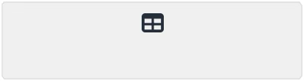
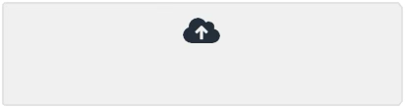
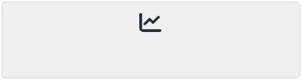
Demo Overview
→
→
Create Table
Load Data from S3
Analyze with SQL

Slide 8
Thank you!
Guilherme Nogueira

Slide 9
